Slide 1
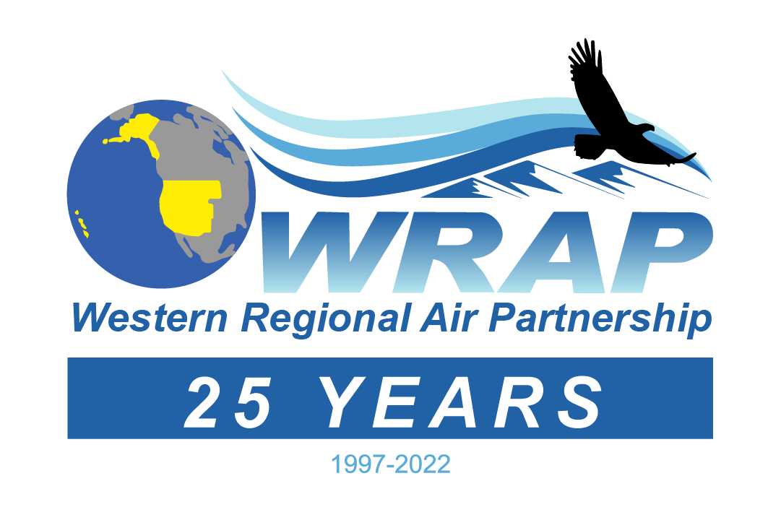
The first 25 years of WRAPing
A brief history…
1991-96
GCVTC
1997-2003
Formation & first (ever) Regional Haze plans
2004-10
RHR Round 1 plans
2011-16
Projects & Expansion to other pollutants
2017-now
RHR Round 2 plans
Conception
Birth & Early Life
Growth & Development
Teen/Young Adult Experimentation
Responsible Adulthood
1990 Clean Air Act Amendments – advise EPA
Western Governors’ Association
Colorado Plateau
GCVTC Recommendations
1999 Regional Haze Rule
WGA & National Tribal Environmental Council
RHR §309 plans submitted 2003
Increasing funding
Specific tasks & planning timeline via active working groups
Generous Congressional funding
Specific tasks & planning timeline via stable active working groups
WGA & NTEC
new Charter 2010
Oct. 2013: start WESTAR hosting
revised Charter 2014
Added non-EPA project funding
Significant regional modeling, fire emissions, web decision support systems projects
Little WG activity
revised Charter Feb. 2022 (subject to membership approval)
Specific tasks & planning timeline via stable active working groups
hosted by WESTAR

Slide 2
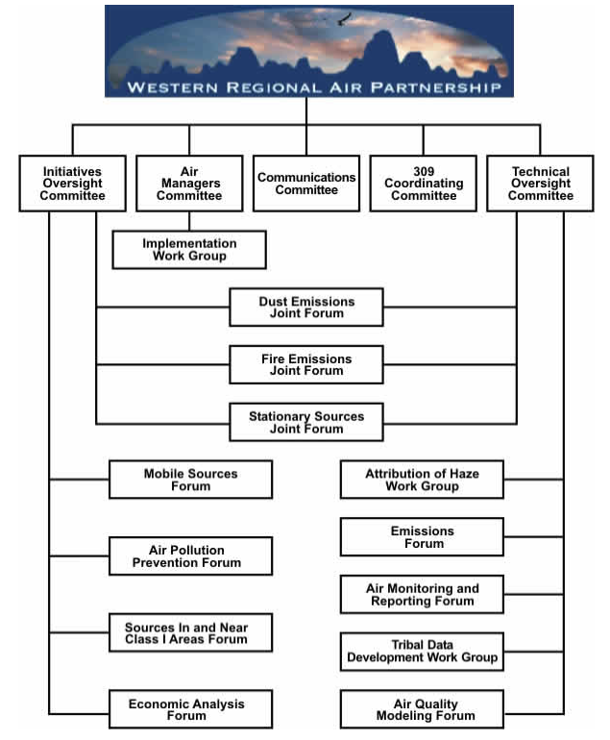
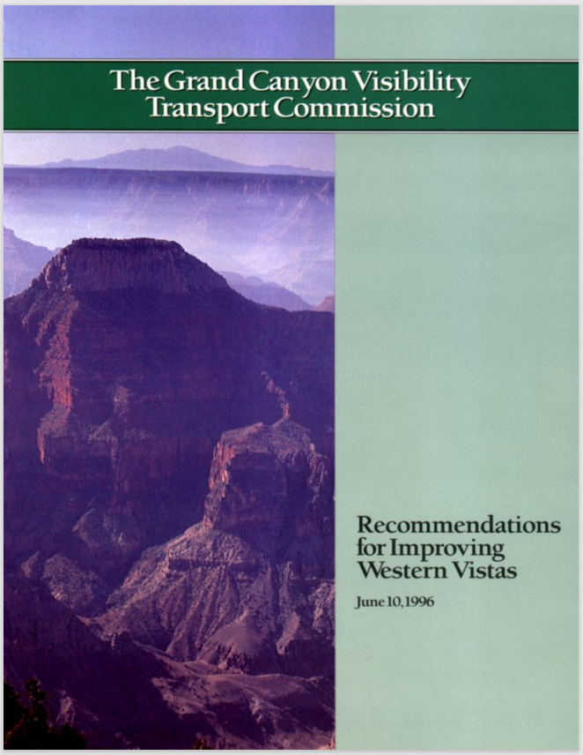
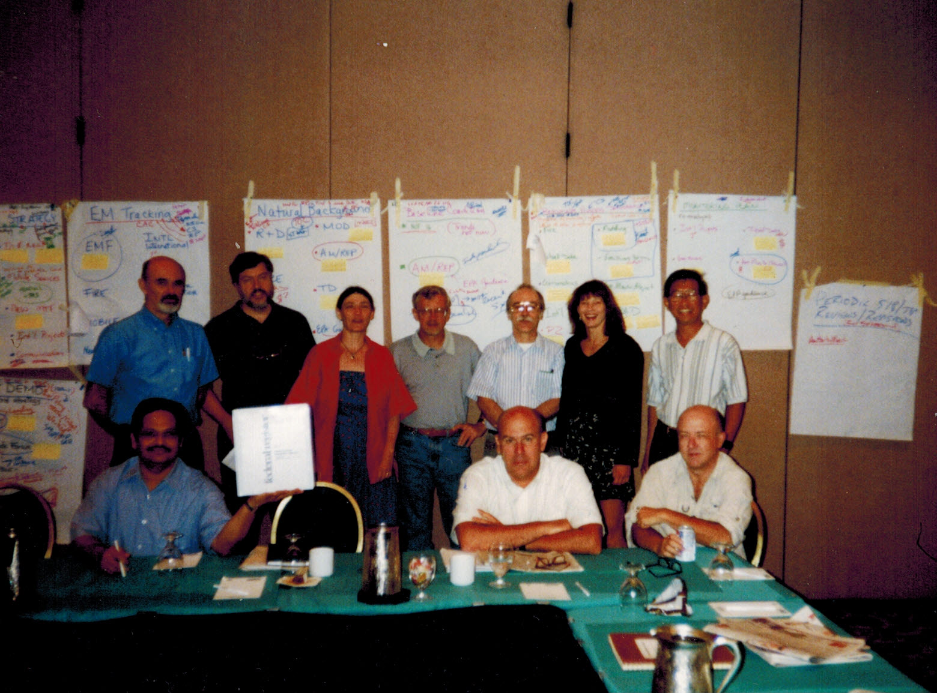
The first 25 years of WRAPing
1997 through 2010
”natural” conditions !?
fire & dust emissions
circa 2004
RHR §308 AND §309
Is NOx BART combustion or post-combustion controls ?
Controllable vs. uncontrollable
Renewable Energy / Energy Efficiency goals
mobile source “significance”
BART & “better than BART”
“Worst” & “Best” days
2018 projections
Clean Air Corridors
Tribal set-aside
oil & gas
WRAP Research & Development Forum
August 1999
Climate change impacts real & noticeable

Slide 3
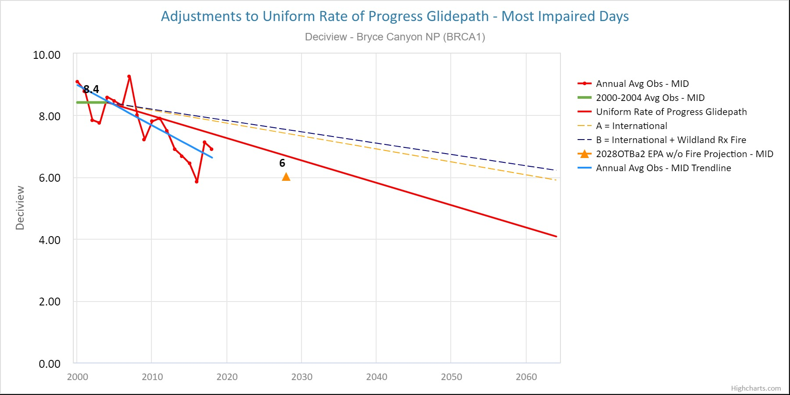
The first 25 years of WRAPing
revised ”natural” conditions (really !?)
2011 through now
fire, smoke, & more fire emissions
Controllable vs. uncontrollable
DEASCO₃ & PMDETAIL
Intermountain West Data Warehouse / Western Air Quality Study (IWDW/WAQS)
WRAP Board of Directors
Technical Steering Committee
WRAP / WESTAR Staff
Administrative Subcommittee on Funding
Work Groups: RHPWG, FSWG, OGWG, RTOWG, TDWG
Work Group Subcommittees
Project Teams
Coordination with WESTAR Planning & Technical Committees
What is “reasonable progress”?
Stationary Sources – control cost, remaining useful life, & federal enforceability
“Most (anthropogenically?) Impaired” and & “Clearest” days
mobile sources still significant
Drill Rig NO₂ Emissions Study
2028 projections
Circa 2021
RHR §309 not quite done (at EPA) AND a new round of §308 planning
Background ozone & interstate transport
Oil & gas !!
Climate change impacts more real & more noticeable

Slide 4
final program agenda for April 5, 2022
WRAP 25th Anniversary Celebration - Park City, UT
Welcome and opening remarks (10 mins.) (Gordon Pierce, Randy Ashley)
• Acknowledgement of past/present WRAP Board State and Tribal Co-Chairs and members
• The first 25 years of WRAPing
• Overview of celebration program
WRAP formation and early evolution panel (15-20 mins.) emcee: Mike Silverstein
WRAP Entertainment (10-15 mins.) (special prizes) emcee: Mary Uhl
• Jeopardy
• Guess that Class I area
• Poems
Regional Haze program, SIP development, analysis/planning effort panel (15-20 mins.) emcee: Tom Moore
Other achievements as a membership organization / hindsight / where are we now panel (20-25 mins.) emcee: Jay Baker
WRAP-up - Gordon and Randy (5 mins.)
• move to Bear Prefunction room for unstructured continuing celebration
• food and drink service starts at 700 pm - appetizers/hors d’oeuvres for dinner, cash bar, non-alcoholic drinks provided

